Slide 1
Module 19: Security
The Security Problem
Authentication
Program Threats
System Threats
Securing Systems
Intrusion Detection
Encryption
Windows NT

Slide 2
The Security Problem
Security must consider external environment of the system, and protect it from:
  unauthorized access.
  malicious modification or destruction
  accidental introduction of inconsistency.
Easier to protect against accidental than malicious misuse.

Slide 3
Authentication
User identity most often established through passwords, can be considered a special case of either keys or capabilities.
Passwords must be kept secret.
  Frequent change of passwords.
  Use of “non-guessable” passwords.
  Log all invalid access attempts.
Passwords may also either be encrypted or allowed to be used only once.

Slide 4
Program Threats
Trojan Horse
  Code segment that misuses its environment.
  Exploits mechanisms for allowing programs written by users to be executed by other users.
Trap Door
  Specific user identifier or password that circumvents normal security procedures.
  Could be included in a compiler.
Stack and Buffer Overflow
  Exploits a bug in a program (overflow either the stack or memory buffers.)

Slide 5
System Threats
Worms – use spawn mechanism; standalone program
Internet worm
  Exploited UNIX networking features (remote access) and bugs in finger and sendmail programs.
  Grappling hook program uploaded main worm program.
Viruses – fragment of code embedded in a legitimate program.
  Mainly effect microcomputer systems.
  Downloading viral programs from public bulletin boards or exchanging floppy disks containing an infection.
  Safe computing.
Denial of Service
  Overload the targeted computer preventing it from doing any sueful work.

Slide 6
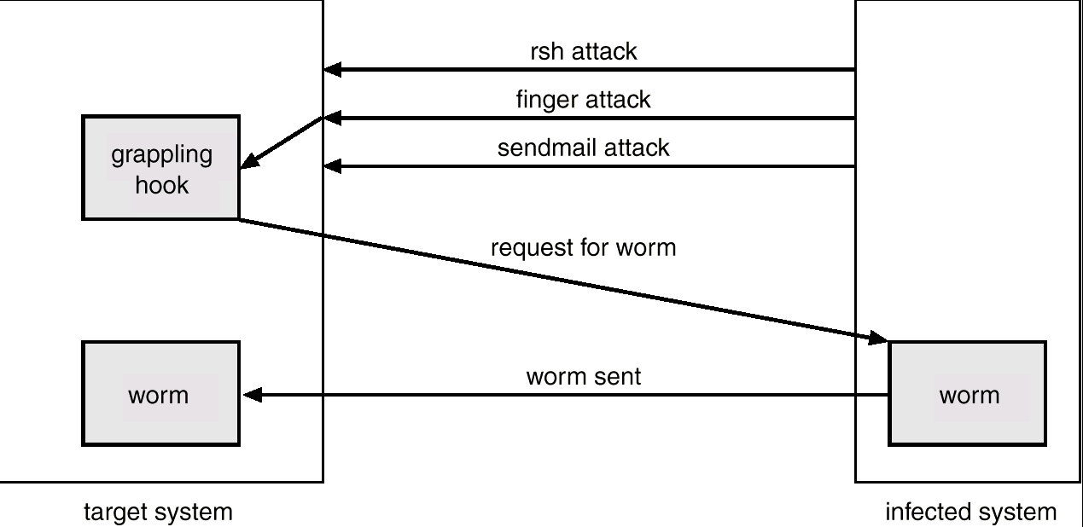
The Morris Internet Worm

Slide 7
Threat Monitoring
Check for suspicious patterns of activity – i.e., several incorrect password attempts may signal password guessing.
Audit log – records the time, user, and type of all accesses to an object; useful for recovery from a violation and developing better security measures.
Scan the system periodically for security holes; done when the computer is relatively unused.

Slide 8
Threat Monitoring (Cont.)
Check for:
  Short or easy-to-guess passwords
  Unauthorized set-uid programs
  Unauthorized programs in system directories
  Unexpected long-running processes
  Improper directory protections
  Improper protections on system data files
  Dangerous entries in the program search path (Trojan horse)
  Changes to system programs: monitor checksum values

Slide 9
FireWall
A firewall is placed between trusted and untrusted hosts.
The firewall limits network access between these two security domains.

Slide 10
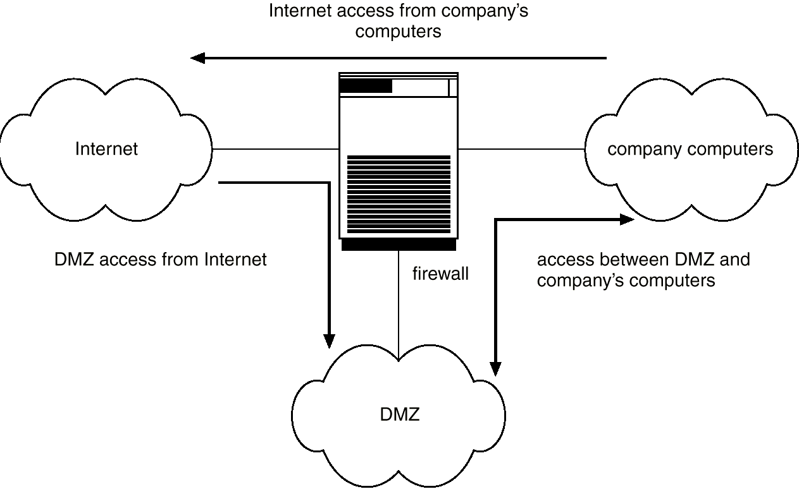
Network Security Through Domain Separation Via Firewall

Slide 11
Intrusion Detection
Detect attempts to intrude into computer systems.
Detection methods:
  Auditing and logging.
  Tripwire (UNIX software that checks if certain files and directories have been altered – I.e. password files)
System call monitoring

Slide 12
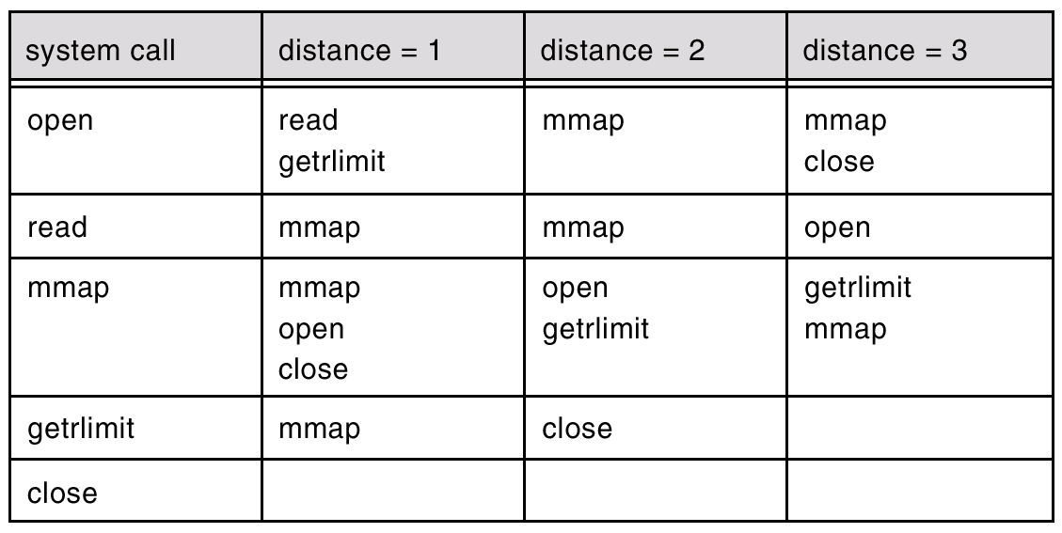
Data Structure Derived From System-Call Sequence

Slide 13
Encryption
Encrypt clear text into cipher text.
Properties of good encryption technique:
  Relatively simple for authorized users to incrypt and decrypt data.
  Encryption scheme depends not on the secrecy of the algorithm but on a parameter of the algorithm called the encryption key.
  Extremely difficult for an intruder to determine the encryption key.
Data Encryption Standard substitutes characters and rearranges their order on the basis of an encryption key provided to authorized users via a secure mechanism. Scheme only as secure as the mechanism.

Slide 14
Encryption (Cont.)
Public-key encryption based on each user having two keys:
  public key – published key used to encrypt data.
  private key – key known only to individual user used to decrypt data.
Must be an encryption scheme that can be made public without making it easy to figure out the decryption scheme.
  Efficient algorithm for testing whether or not a number is prime.
  No efficient algorithm is know for finding the prime factors of a number.

Slide 15
Encryption Example - SSL
SSL – Secure Socket Layer
Cryptographic protocol that limits two computers to only exchange messages with each other.
Used between web servers and browsers for secure communication (credit card numbers)
The server is verified with a certificate.
Communication between each computers uses symmetric key cryptography.

Slide 16
Computer Security Classifications
U.S. Department of Defense outlines four divisions of computer security: A, B, C, and D.
D – Minimal security.
C – Provides discretionary protection through auditing. Divided into C1 and C2. C1 identifies cooperating users with the same level of protection. C2 allows user-level access control.
B – All the properties of C, however each object may have unique sensitivity labels. Divided into B1, B2, and B3.
A – Uses formal design and verification techniques to ensure security.

Slide 17
Windows NT Example
Configurable security allows policies ranging from D to C2.
Security is based on user accounts where each user has a security ID.
Uses a subject model to ensure access security. A subject tracks and manages permissions for each program that a user runs.
Each object in Windows NT has a security attribute defined by a security descriptor. For example, a file has a security descriptor that indicates the access permissions for all users.

